Slide 1
MICROCONTROLLERS

Slide 2
A microcontroller is an integrated circuit (IC) that can be programmed to perform a set of functions to control a collection of electronic devices.
A self-contained system in which a processor, support, memory, and input/output (I/O) are all contained in a single package.
Being programmable is what makes the microcontroller
unique.

Slide 3
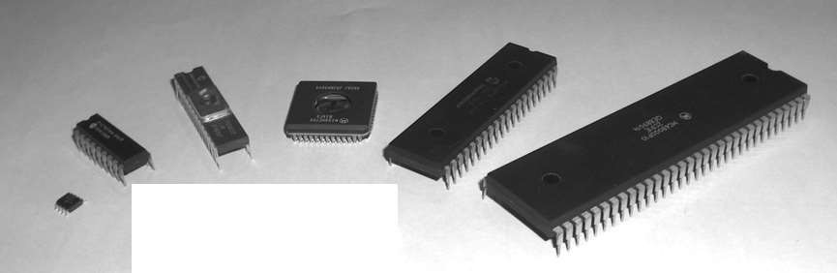
From left to right: PIC 12F508, PIC 16F84A, PIC 16C72, Motorola 68HC05B16, PIC 16F877, Motorola 68000

Slide 4
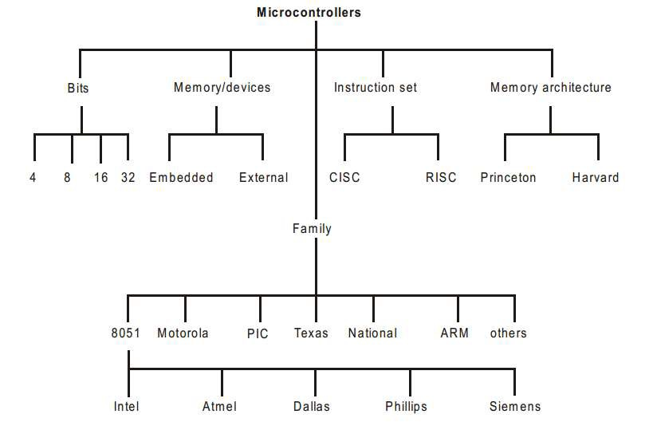

Slide 5
1 – ACCORDING TO BITS
4-BIT MICROCONTROLLERS
ALU performs arithmetic and logical operations on a nibble (4-bits) at an instruction.
Internal bus width of 4-bit.
Small size, minimum pin count and low cost controllers.
Low power consumption and used for low end applications
like LED & LCD display drivers, portable battery chargers.
Examples: Renasa M34501 256 and ATAM862 series from ATMEL.

Slide 6
8-BIT MICROCONTROLLER
ALU performs arithmetic and logical operations on a byte (8-bits) at an instruction.
Internal bus width of 8-bit.
Examples: Intel 8051 family family.
and Motorola MC68HC11

Slide 7
16-BIT MICROCONTROLLER
ALU performs arithmetic and logical operations on a word (16-bits) at an instruction.
Internal bus width of 16-bit microcontroller is of 16-bit.
Enhanced performance, computing capability and
precision as compared to the 8-bit microcontrollers.
greater
Examples: Intel 8096 family, Motorola MC68HC12 and
MC68332 families.

Slide 8
32-BIT MICROCONTROLLER
ALU performs arithmetic and logical operations on a double word (32-bits) at an instruction.
Internal bus width of 32-bit.
Much more enhanced performance, computing capability with
greater precision as compared to 16-bit microcontrollers.
Examples: Intel 80960 family, Motorola M683xx and
Intel/Atmel 251 family.

Slide 9
2 - ACCORDING TO MEMORY/DEVICES
EMBEDDED MICROCONTROLLERS
An embedded system has a microcontroller unit that has all the functional blocks (including program as well as data memory) available on a the same chip.
Example: 8051 having Program & Data Memory, I/O Ports, Serial Communication, Counters and Timers and Interrupt Control logic on the chip.

Slide 10
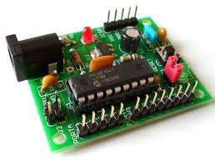

Slide 11
EXTERNAL MEMORY MICROCONTROLLERS
An external system has a microcontroller unit that does not have all the functional blocks available on a chip.
All or part of the memory units are externally interfaced using an interfacing circuit called the glue circuit.
Example: 8031 has no program memory on the chip.

Slide 12
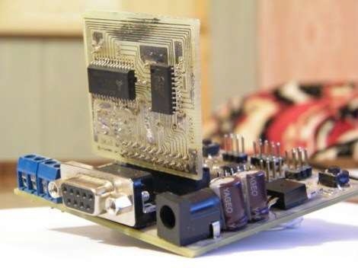

Slide 13
3 - ACCODING TO INSTRUCTION SET
CISC (COMPLEX INSTRUCTION SET COMPUTER)
ARCHITECTURE MICROCONTROLLERS
Has an instruction set that supports many addressing modes for the arithmetic and logical instructions, data transfer and memory accesses instructions.
Many of the instructions are macro like.
Allows the programmer to use one instruction in place of
many simpler instructions.
Example: Intel 8096 family.

Slide 14
RISC (REDUCED INSTRUCTION SET COMPUTER)
ARCHITECTURE MICROCONTROLLERS
Contains an instruction set that supports fewer addressing modes for the arithmetic and logical instructions and for data transfer instructions.
Allows simultaneous access of program and data.
Instruction pipelining increases execution speed
Allow each instruction to operate on any register or use any addressing mode.
Smaller chip and pin count.
Very low power consumption.

Slide 15
4 - ACCORDING TO MEMORY ARCHITECTURE
The architectures of microcontrollers differ in the way data and programs are stored and accessed.
VON-NEUMAN /PRINCETON ARCHITECTURE
Single data bus that is used to fetch both instructions and data.
Program instructions and data are stored in a common main memory.
When such a controller addresses main memory, it first fetches an instruction, and then it fetches the data to support the instruction.

Slide 16
Simplifies the microcontroller design because only one memory is accessed.
The weakness is that two separate fetches can slow up the controller’s operation.
Example: Motorola 68HC11.

Slide 17
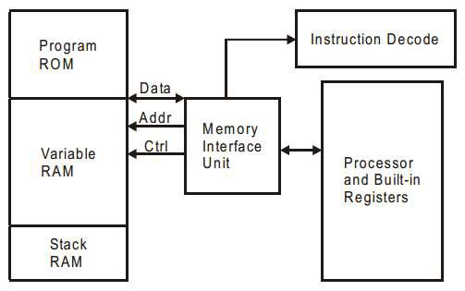

Slide 18
HARVARD ARCHITECTURE
Separate data bus and an instruction bus.
Execution occur in parallel.
Much faster execution than Von-Neuman architecture.
Design complexity.
Example: intel MCS-51 family and PIC microcontrollers.

Slide 19
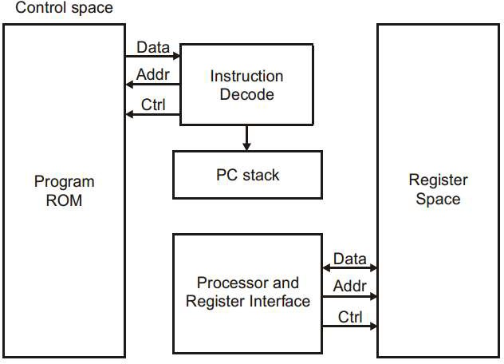

Slide 20
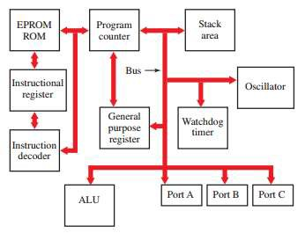

Slide 21
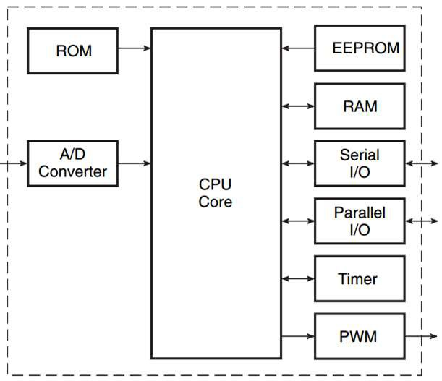

Slide 22
Central Processing Unit (CPU)
The central processing unit processes the program. It executes the instructions stored in the program memory pointed to by the program counter in synchronization with the clock signal.
ALU
The arithmetic/logic unit (ALU) performs mathematical and logical operations on data.
Oscillator
A complex digital device that generates steady pulse rate required for timing. All of the separate functions are controlled by one central timing system. The timing pulse provides the basis for proper sequence of all the separate sections of the microcontroller chip.

Slide 23
Read Only Memory (ROM)
ROM holds the program instructions and the constant data. Microcontrollers use one or more of the following memory types for this purpose:
ROM (mask-programmed ROM),
PROM (one-time programmable ROM, which is not field
programmable),
EPROM (field programmable and usually UV erasable),
EEPROM (field programmable, electrically erasable, erasable) and flash (similar to EEPROM technology).
Microcontrollers can have 4K, 8K and 16K, etc. of ROM
byte

Slide 24
Random Access Memory (RAM)
is used to hold intermediate results and other temporary data during the execution of the program. Typically, microcontrollers have a few hundreds of bytes of RAM.
Special-Function Registers
control various functions of a microcontroller. These are divided into two groups:
Registers wired into the CPU
Do not necessarily form part of addressable memory.
Used to control program flow and arithmetic functions.
Examples, status register, program counter, stack
pointer, etc.

Slide 25
Registers
Register is used manipulated.
to hold the contents of data being
Registers required by peripheral components
The contents of these registers include set a timer or enable serial communication.
Examples, a program counter, stack pointer, RAM address register, program address register and PC incrementer.

Slide 26
Peripheral Components
The analogue-to-digital converter - provides an interface between the microcontroller and the sensors that produce analogue electrical equivalents of the actual physical parameters to be controlled.
The digital-to-analogue converter - provides an interface between the microcontroller and the actuators that provide the control function.
I/O ports - provide an interface between the microcontroller and the peripheral I/O devices such as the keyboard, display, etc.
Counters/timers - are used to keep time and/or measure the time interval between events, count the number of events and generate baud rates for the serial ports.

Slide 27
Watchdog timer
A specialized program found as part of the microcontroller designed to prevent the microcontroller from halting or “locking up” because of a user-written program since the instructions are processed step-by-step.
Uses a routine that is based on timing. If a program has not been completed or repeated as a loop within a certain amount of time, the watchdog timer issues a reset command.
A system reset sets all the register values to zero.
The reset feature allows the controller to recover from the crash. It releases the program and sets the controller to start over again.

Slide 28
Stack Pointer and Program Counter
Stack pointer - keeps track of the last stack location used while the processor is busy manipulating data values, checking ports, or checking interrupts.
Program counter - is used to hold the address of the instruction to be executed next.
Buses
Bus represents a physical connection used to carry a signal from one point to another inside a microcontroller. The signal carried by a bus may represent address, data, control signal, or power.

Slide 29
MODULE
When a microcontroller is mounted on a circuit board with other components function as a single unit, is referred as a module or a microcontroller board.
A microcontroller module typically consists of microcontroller, a power source, an interface for connecting to a programming device, I/O ports, and additional memory.

Slide 30
A power source - powers the microcontroller and any accompanying components located on the printed circuit board.
An interface - communicate with the controller.
A set of input/output (I/O) ports - send and receive signals from the devices the microcontroller is designed to control.
I/O ports when programmed as an output pin, each pin can output digital signals. When programmed as an input pin, each pin can receive digital signals.
Digital-to-analog and analog-to-digital converters change the digital pulses into analog signals.

Slide 31
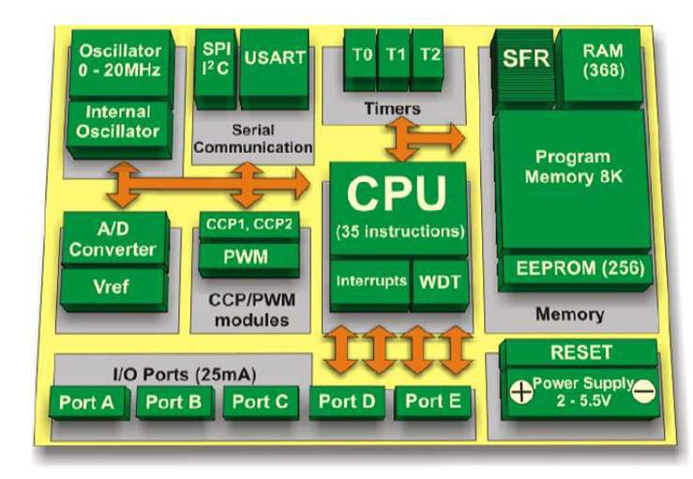

Slide 32
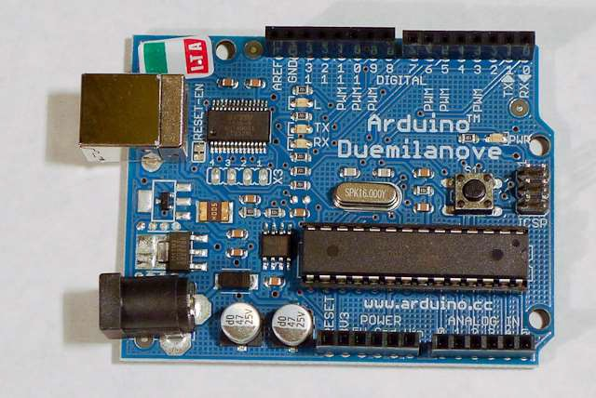

Slide 33
The microcontroller consists of thousands of digital circuits that are combined into areas to provide specific functions.
The parts of the microcontroller are used to save data and programs, perform math and logic functions, and generate timing signals.
The different areas are connected by a bus system. The bus system contains tiny parallel circuits that carry the digital pulse patterns from section to section.
The ROM stores the program required for the microcontroller to function and controls how the chip components operate and how data and instructions flow through the chip.
RAM stores programs and data temporarily.
Ports and registers are special memory locations dedicated to a specific function such as a hardware location or a place to manipulate data.

Slide 34
ADVANTAGEOUS FEATURES
Easy to use and Programmable.
Reusable - Ability to reprogram using Flash, EEPROM or EPROM.
Flexibility and dependable.
Design and Simulation.
Energy efficient, small and cost effective.
Ports multifunctionality.
High Integration and can fit inside other devices.
Easy upgrade.

Slide 35
AREAS OF MICROCONTROLLER APPLICATION
Home monitoring system.
Automotive applications such as robotics.
Appliances such as microwave oven, refrigerators, television and VCRs, stereos.
Automobiles in engine control, diagnostics, climate control.
Environmental control in greenhouse, temperature, humidity, factory, home.
Instrumentation.
Aerospace.

Slide 36

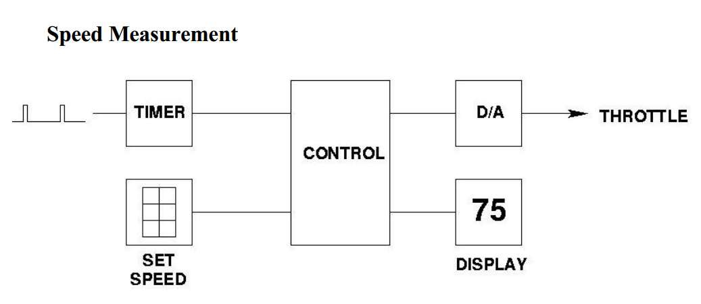
Throttle – a device that control the flow of fuel or power to an engine.

Slide 37

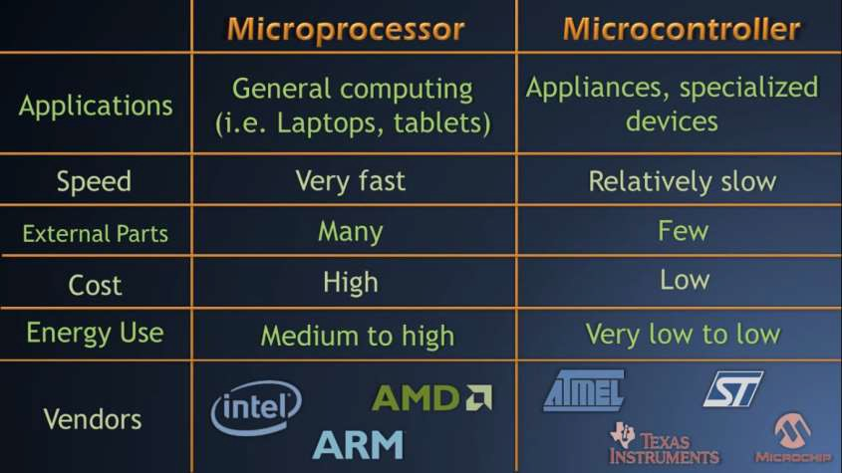

Slide 38
CRITERIA OF CHOOSING A MICROCONTROLLER
1 - Meeting the computing needs of the task at hand efficiently and cost effectively:
Speed
Packaging
Power consumption
The amount of RAM and ROM on chip
The number of I/O pins and the timer on chip
How easy to upgrade to higher performance or lower power-
consumption versions
Cost per unit

Slide 39
2- Availability of software development tools, such as compilers,
assemblers, and debuggers.
3 - Wide availability and reliable sources of the microcontroller
Example: The 8051 family has the largest number of diversified (multiple source) suppliers
Intel (original)
Atmel
Philips/Signetics
AMD
Infineon (formerly Siemens)
Matra
Dallas Semiconductor/Maxim

Slide 40
END OF PRESENTAION
THANK YOU

